Slide 1

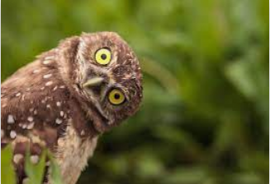
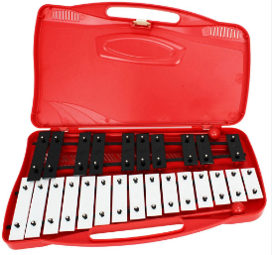
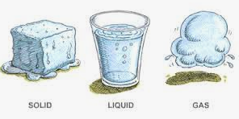



Welcome to Year 4
Owls class

Slide 2
Year 4 Staff
Class Teacher: Mr Blackhurst
Learning Support Assistants:
Mrs Joy Mrs Farrell

Slide 3
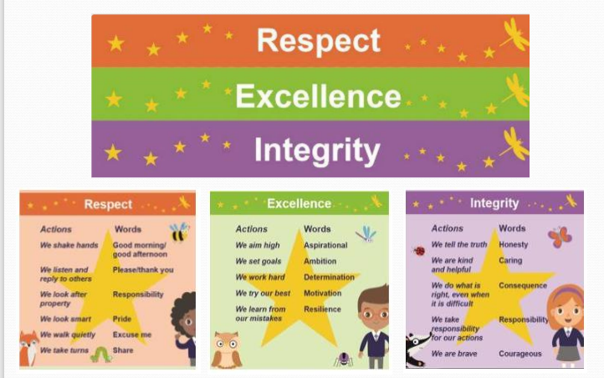
Our School values

Slide 4
Lessons
In Reading we study a variety of texts which have been specifically chosen for Year 4 – we are starting the year off with Manfish a biography of Jacques Cousteau. The children have daily reading sessions full of discussion about the events, characters and settings.
In English, we are using our reading novel as a stimulus to write some fantastic work such as character descriptions and adventure stories.
In Maths, we follow the White Rose Scheme of work. We focus on fluency, reasoning and problem solving where the children not only work out the questions but are able to explain their answers too. Times tables is a main focus, as well as working on arithmetic (addition, subtraction, multiplying, dividing and fractions).

Slide 5

Routines
Children arrive between 8:40 and 8:50.
End of the day - we finish at 3:10pm and children are collected from the hall.

Slide 6

Routines and expectations
Children should come to school in full uniform every
day except PE days when they come in full PE kit (no jewellery).
PE – Monday and Friday.
Please ensure all uniform including jumpers and PE kits are named.
We encourage children to bring in a named water bottle everyday.

Slide 7


Homework
Every week the children are set times tables practice on TT Rockstars.
At Heathlands, we read EVERY DAY. The children are sent home with a book band book at their level and fill in their reading logs when they have read at home – signed by a parent or carer. House points are awarded for every signed read in their reading log.
Reading logs should be handed in everyday to be checked.

Slide 8


Rewards
In Owls class we have lots of rewards:
Earning house points for the whole class linked to a whole school value.
House points – each child is part of a house team (Air, Fire, Lightning and Water) and can earn house points for themselves and for their team by showing our school values.
Weekly certificate in whole school assembly for somebody who has worked particularly hard in lessons.
Afternoon Tea for children showing the school values.

Slide 9

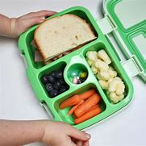
What does your child need to bring each day?
Named water bottle
Named lunch box (to be placed on the lunch trolley in the hall each morning) if not having school lunches.
Correct uniform including a coat and black school shoes – all named

Slide 10
How can you support your child at home?
Read, read, read – encourage your child to read independently and listen to them read to you as often as possible. It is just as essential in Year 4 to hear them read as it is when they are in Reception.
2) Practise times tables – use TT Rockstars or Hit the Button to help.
3) Having a conversation and showing an interest in their learning and school day.

