Slide 1

Welcome to
Heathlands Primary Academy and
Pre-School

Slide 2

What class will my child be in?
They will be in Butterfly Class!

Slide 3
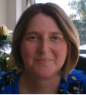

Staff
Mrs. Hunnisett - Class Teacher / Early Years Lead
Mrs. Evans – Class support staff.
Miss Harries - Head Teacher Mr Golding - Deputy Head
Mrs. Harris - SENCO
Mrs. Yannick/Mr Wheatley - Admin Officers
Marie Bothamley - Pupil and Family Support Worker
A full list of our staff is on our website.

Slide 4

The Heathlands Way
Children will be introduced to our school values. These underpin all that we do at Heathlands and form the foundations of our behaviour and curriculum policy.

Slide 5
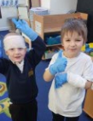
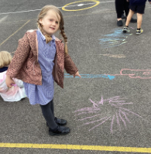
Teddy bear Club
Teddy bear clubs provides an opportunity for your child to familiarise themselves with their new classroom and teachers. Please ensure your child attends these sessions. They will need a named water bottle and a teddy bear for BOTH sessions.
Dates for your diary:
27th June – this will be half a class at a time, each child to have an adult attend. Please check previous correspondence to see which session you have been allocated. 9.30 - 10.15 or 10.30 - 11.15.
11th July 9.30-10.30 – all children to attend without adults. If your child is attending our Caterpillar nursery on that day they will be collected by staff.

Slide 6
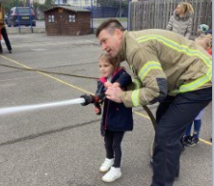
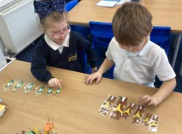
Starting School
All children will start school on a part-time basis. This allows children to settle into a new environment and for staff to get to know each child individually.
Dates for your diary:
4th, 5th and 8th Sept - mornings only 8.40-12.00
9th – 12th Sept- mornings only, including lunch 8.40- 1.00
Week beginning 15th Sept- all day 8.40- 3.00
Baseline – identifies what they know already and areas to work on.

Slide 7

Getting ready for school
You have already done lots of hard work to get them ready but it would be helpful if they could:
Use the toilet independently, wipe and wash their hands.
Dress and undress independently, including their coats. We can show you the magic superhero way if you need us to! Velcro or slip on shoes are helpful rather than laces!
Use a knife and fork with some independence. They will need to be able to cut up their own food and feed themselves.
Recognise their name so they can find it on their peg.
Remember, if you are nervous, they will they be too - so deep breaths and help them see they are going to have fun! This will help them feel more confident.

Slide 8

What do you need to do?
Purchase uniform and bookbag.
Complete online admission form (called Applicaa). A link for the form is on the school website – new starters. If you have not done this yet – there is an envelope in your pack with log in details.
Decide on lunches - order online or pick a great lunch box!
Let us know if there is anything you are worried about before starting so we can help support you and your child.

Slide 9
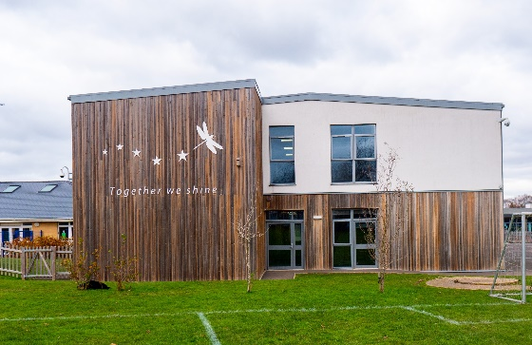
School Day
Doors open at 8.40am.
Please bring your child through the front playground.
Please say goodbye at the door to encourage independence.
Pick up is at 3pm on the playground.

Slide 10
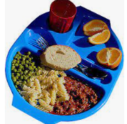
Lunches
Children eat together. Staff are there to support where needed and this is a sociable time.
Children can be provided with a FREE school lunch. Menus must be chosen by you online in advance.
If you prefer you can send in a healthy packed lunch.
Please remember that we encourage a nut-free school due to allergies and sweets, chocolate bars, energy/fizzy drinks are not accepted.

Slide 11
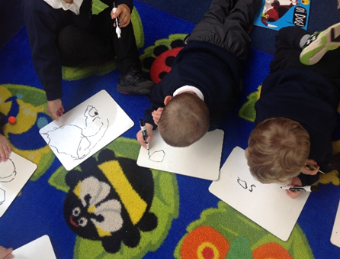

The Early Years Foundation Stage (EYFS) Curriculum
Prime areas which work together and support development in all other areas.
Personal, Social and Emotional Development
Communication and Language
Physical Development
Specific areas include essential knowledge and skills.
Literacy
Mathematics
Understanding the World
Expressive Arts and Design

Slide 12

How will you know what my child can do?
Each area of learning has its own set of Early Learning Goals which determine what children are expected to achieve by the end of the Reception year.
We will report to you on this throughout the year.
Open door

Slide 13

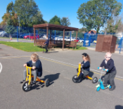
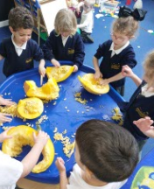
Learning in Reception Class
Children learn through play and active learning both indoors and outside.
They will work individually, in groups and as a class.
Staff will support children through their play through directed learning.
All children will develop at their own rate.
A planned weekly PE session with sports coaches. They will need navy/black joggers, white t shirt, trainers, NO jewellery/earrings. Come in to school in PE clothes every Monday once children are in full time.

Slide 14
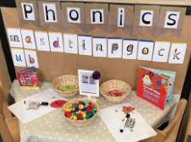

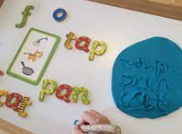
Teaching Reading and Writing
Right from the start of Reception, children will have a daily phonics lesson which follows the progression for Little Wandle Letters and Sounds and this continues in Year One to ensure children become fluent readers.
In Reception, we build from 10-minute lessons, with additional daily oral blending games, to the full-length lesson as quickly as possible. Each Friday, we review the week’s teaching to help children become fluent readers. Children make a strong start in Reception: teaching begins in Week 2 of the Autumn term.

Slide 15


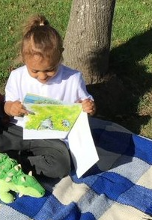
Reading
Before your child comes home with a reading book they will need to learn the letter sounds.
Once they know some sounds we will send a book home. Children read this book three times to build confidence and fluency.
We will send home the letters being learnt so you can follow the scheme with us.
‘Love of Reading’ books

Slide 16



How can you help?
Ensure your child is in school on time every day, unless they are unwell.
Contact the school by 9.15am if your child is absent.
Bring your child’s book bag every day.
Make sure your child wears correct school uniform and it is all clearly named so we can return it if it gets lost or left behind.
Send a water bottle with fresh water in with your child.
Talk with your child about their learning.
Complete any home learning tasks.
There are opportunities for you to contribute to this through ‘WOW moment’ slips
Let school know if you or your child are worried about anything. We can only help if we know!

Slide 17
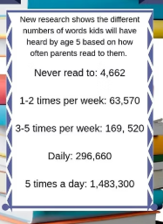


Read stories with them at home daily.

Slide 18
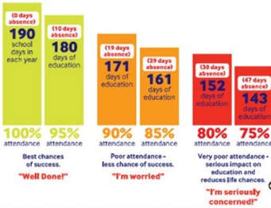
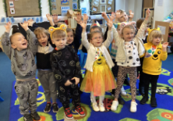
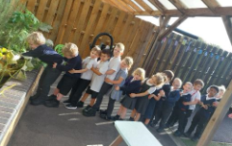
Attendance matters

Slide 19

Communication
All communication goes out by email or text so make sure we have an up to date email and check it regularly!
Newsletters will come out every half term.
School website has lots of information so please browse!
Parent consultation evenings happen once per term.
Reports to parents happen in summer term.
Class email is a good way to communicate.
The class teacher is always your first port of call for any issues, but if in doubt please call the office and someone will come back to you.
www.heathlandsprimarybournemouth.co.uk

Slide 20
We look forward to seeing you in September!
If you have any questions, please just ask.

