Slide 1

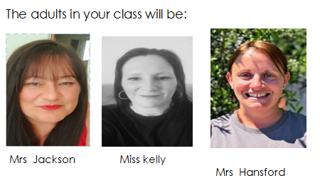
Year 2 Information

Slide 2


The Year 2 Team

Slide 3


Year 2 English
What does English look like in Year 2?
Reading sessions with a high quality text, teaching children comprehension skills as well as expanding their vocabulary
English lessons, involving drama and writing, based around fiction, non-fiction and poetry
Spelling incorporated into phonics and English lessons
Daily phonics to teach and recap sound families taught in Year 1 and sounds for children who are securing Phase 2 – 5 sounds and words.
Daily handwriting practice
Notes:
NK

Slide 4


English at Home
Practise spelling Year 1 and Year 2 Common Exception Words regularly.
Each half term we will send home a copy of your child’s assessment to inform you of the words that you can support them with.
Correct handwriting/letter formation at home
Notes:
NK

Slide 5

Reading Approach at Heathlands
Reading is prioritised
Foster life long ‘love of reading’
Special ‘Must Read’ books in class
Love of Reading books to share
Taking part in book celebrations e.g. World Book Day
Reading competitions and challenges
Daily ‘Snuggle Reading’
New library! to come Autumn 2025
Notes:
EG

Slide 6
Reading
  MONDAY: 1 X Book band books (to practise phonics)
  Friday: Book band books (to practise phonics)
Children should be successful in reading the book they bring home
Reading with your children should be everyday, you can read to them so that they can access high quality language and be inspired to read.
Notes:
EG

Slide 7
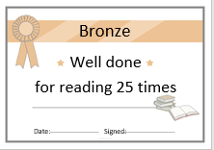



Reading Awards
10 reads = sticker
25 reads = bronze certificate and a sticker
50 reads = silver certificate and wrist band
75 reads = gold certificate and a bookmark
100 reads = certificate from Miss Harries and a book
All home and in school reads are counted in
the reading logs
Notes:
SO

Slide 8

Reading Record comments
12/9 – Read with mummy
14/9 – Great reading today!
Please write in the log every time you read so your child does not miss out on any rewards ☺
Notes:
SO

Slide 9
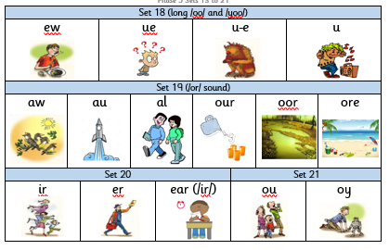
Phonics
Phonics in Year 2 will be taught daily for the first half term to support transition from Year One as well as to diminish any gaps in prior learning
Taught in sound families (sets)
Highly structured and carefully sequenced with opportunities for active learning
The children who did not pass in June 2025 will take the statutory Phonic Screen in June 2026.
Notes:
SO

Slide 10

Year 2 Maths
Broken down into Number and Shape, Space and Measure
Number – place value (value of each digit in a number) and the 5 operations (addition, subtraction, multiplication, division and fractions)
Shape, Space and Measure – 2D and 3D shapes, data handling, capacity, volume, measurement
Notes:
DC

Slide 11
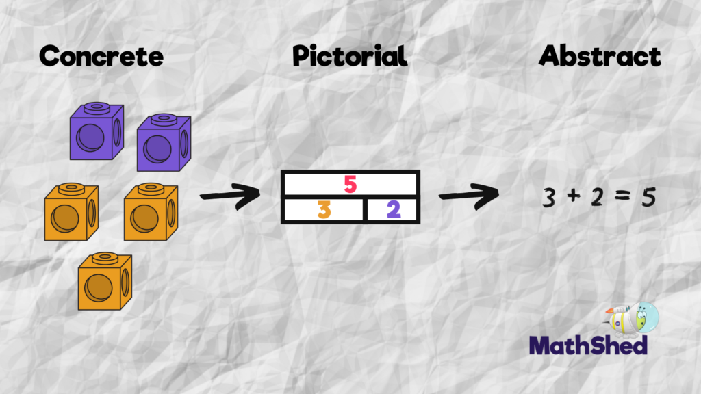
Year 2 Maths
Each lesson will have fluency, reasoning and problem solving
  Fluency – practising skills to support quickly and accurately recalling mathematical facts
  Reasoning – explaining and justifying ideas
  Problem Solving – open ended problems to encourage mathematical thinking.
CPA approach
Number Sense– recalling number facts and procedures – automaticity!
Notes:
DC

Slide 12
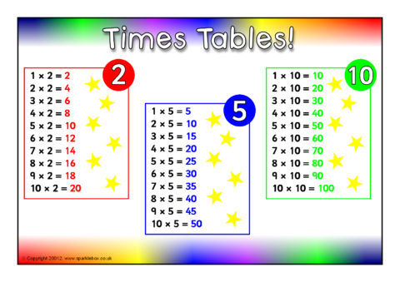
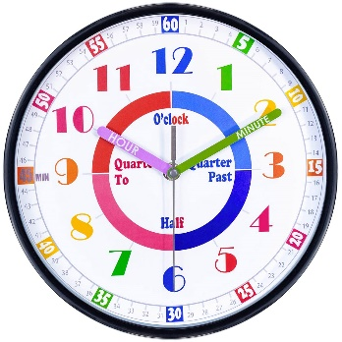
Maths at Home
Learning your 2, 5 and 10 times tables
Recalling number bonds to 20
Place value of 2 digit numbers – how they are made up (tens and ones)
Telling the time- o’clock, half past, quarter to,
quarter past
Playing with coins! Keep money visible at home!
Information on what we will be learning each half term will be provided on our topic overviews each half term.
Notes:
EG

Slide 13
Year 2 Assessment
End of KS1 assessments have become non-statutory from the 2023/24 academic year onwards
Staff will still attend high quality training events run by HIAS to continually develop and train staff
More information about end of Key Stage assessments later in the year.
Phonics screen for those that did not pass 2025 assessment
Notes:
FB

Slide 14

P.E
For indoor P.E, children will continue to wear school uniform – shorts under skirts
Your child’s timetabled outdoor P.E day will change every half term. Please check website/newsletter for updates.
Health and Safety – hair should be tied up and no jewellery on these days
Fun Fit Friday
Mile run/movement breaks
Notes:
NK

Slide 15




Heathlands Values
Excellence Respect Integrity
Notes:
EG

Slide 16
Outside Enrichment Experiences
Designated time every week in the curriculum
Planned, exciting activities that will develop cultural capital and life experiences, following the children’s interests
This may include activities linked to artwork, music, cookery etc.
Notes:
DC

Slide 17

Online Safety
There is a strong focus at Heathlands to keep our children safe online
It links to computing, PSHE and British Values
Every year we hold an ‘Online Safety Day’
For more information on how to keep your child safe online, visit the website
Notes:
DC

Slide 18
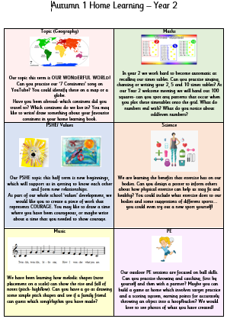
Home learning
Homework will be set at the start of each half term
Home learning books
Celebrated in class ☺
We encourage homework to be completed in pencil rather than pen unless creating posters or other creative pieces
Notes:
FB

Slide 19
Interventions
Interventions are sometimes provided for children. These are additional sessions either for support or challenge
Short sessions in small groups or 1:1 tailored around what the children need
If you are concerned, contact your child’s class teacher
Mrs Harris– Inclusion Lead. Access to additional support. Close working links with relevant agencies. Oversees interventions across all core areas.
Notes:
SO

Slide 20
General Reminders
A member of HLT will be on the door in the morning to take any messages
Please notify office/teacher if someone different is collecting your child
Ensure reading records are in school EVERY DAY!
Please talk to your class teacher if you have any questions or concerns
Please make sure anything brought into school is named. Coats each day.
Notes:
FB

Slide 21

Thank You
Please Feel free to come see the team if you have any questions about Year 2.
Notes:
FB

