Slide 1
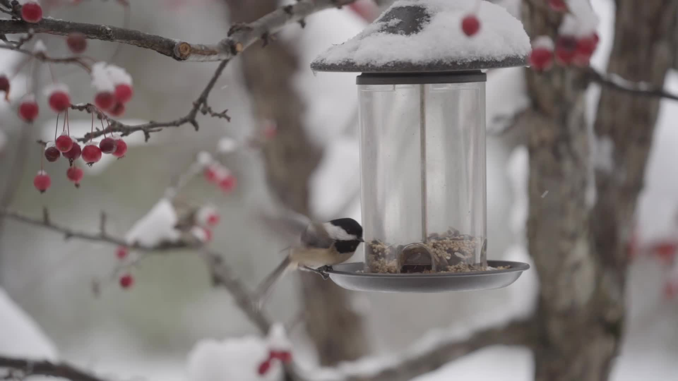
Woodpeckers Class
Year 3 2025 - 2026

Slide 2
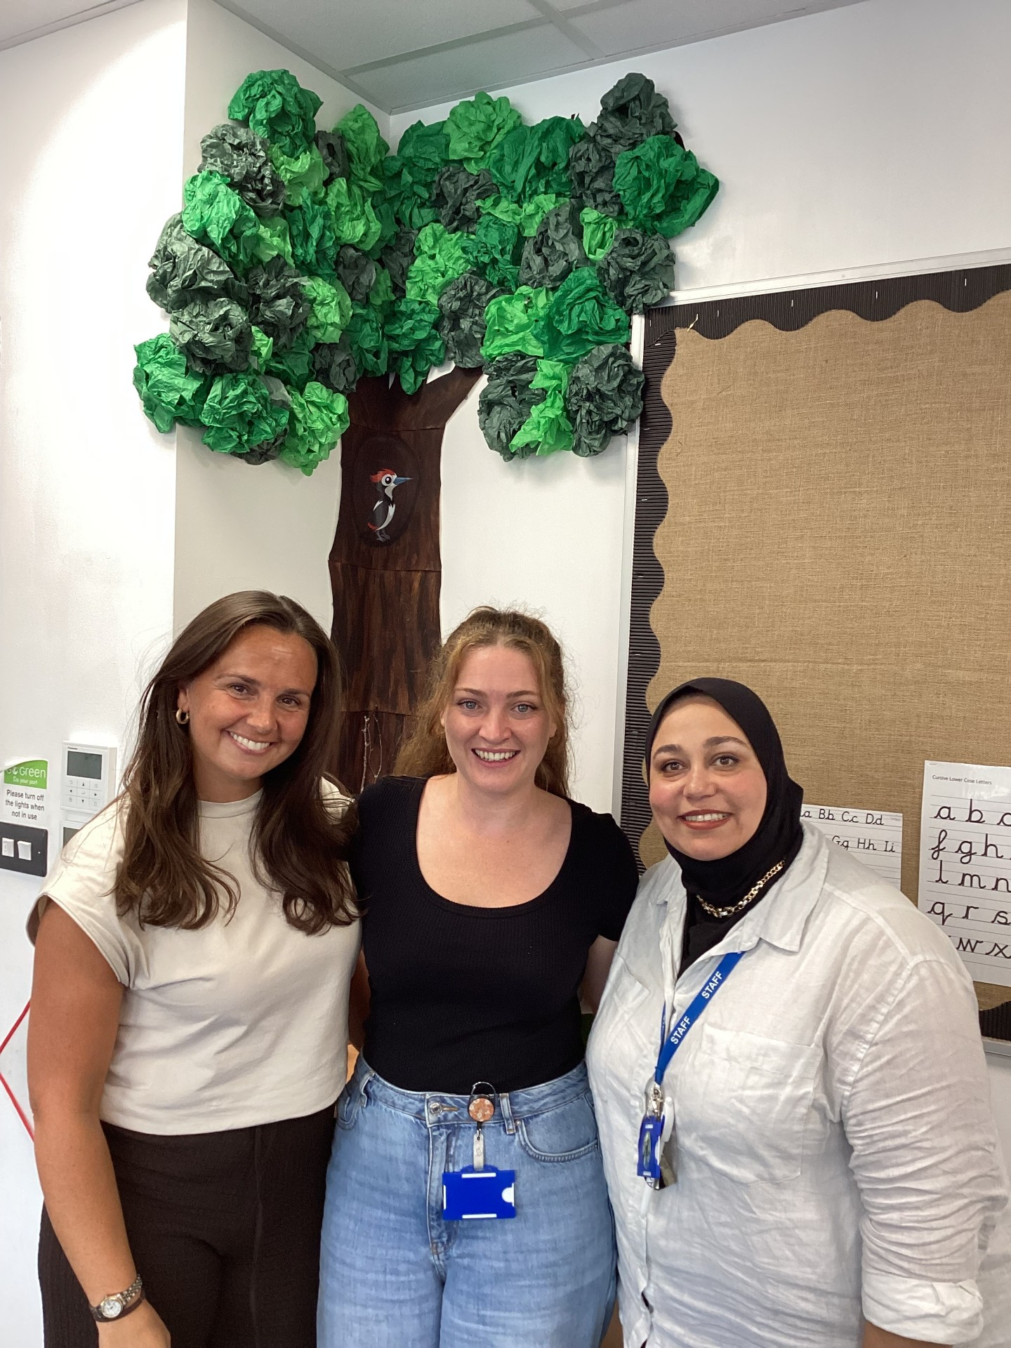
Woodpeckers Staff
Mrs Reeves, Miss Shaw, Mrs Hamza
Class email: woodpeckers.heathlands@coastalpartnership.co.uk

Slide 3
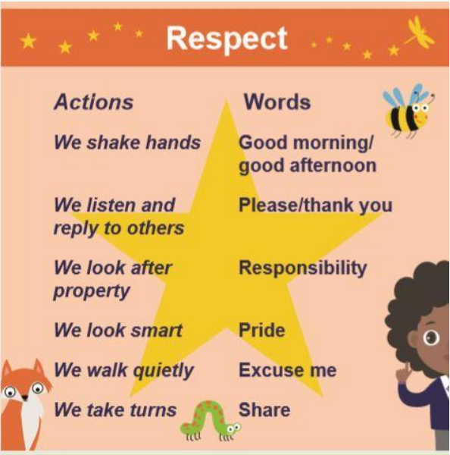
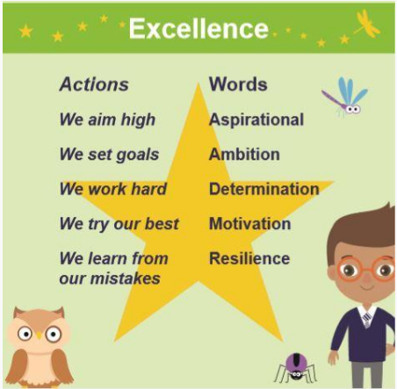
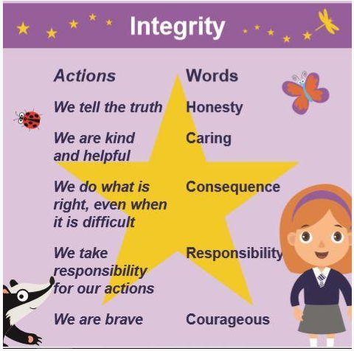
Our School Values

Slide 4
Expectations and Routines
In the morning – Doors to the hall open from 8:40 – 8:55
At the end of the day – Pick up is outside the hall doors on the office side. Children go home at 3:10
Please send your child to school in uniform everyday unless it is a P.E day and make sure their belongings are named.
Your child should bring a water bottle to school everyday.
During Winter, please make sure they come to school with a coat.

Slide 5
P.E
P.E is every Monday and Tuesday.
On a Monday the children work with P.E coaches and on a Tuesday, they work with the classroom teacher.
The children will learn two different sports every half term.
They also have lunchtime sports every Monday, Wednesday and Friday.
Please make sure your child is wearing full P.E kit every Monday and Tuesday.
Jewellery must be removed on P.E Days or your child will not be able to join in.

Slide 6

Celebrations
Assembly - Every Monday we have an assembly to celebrate two children per class. One certificate is to celebrate amazing learning, and the other is to celebrate children that show our school values.
Track-It – The children receive house points daily based on how they are showing school values. They receive certificates when they reach different milestones.
Reading – The children get house points for reading at home
Houses – The children are put into four houses Air, Water, Fire and Lightening. All their house points are put together and announced at assembly on a Monday.
Star Jar – In Woodpeckers class we have a Star Jar. The class decide on a reward when the jar is full. They get stars for working together and showing our school values.

Slide 7

Home Learning
The children are expected to read at least 3 times every week and bring their reading logs into school every day .
There are many opportunities to read in our everyday lives so please include these in their reading logs. E.g. Reading grocery lists, reading recipes, reading instructions and so on. They do not have to read the book from school, if they have something exciting at home that they would rather read, that is fine!
The children receive house points for every read they do.
If your child has finished with their reading book, they need to let classroom staff know, and we will change it as it takes varied amounts of time for different children to finish different books.
In Spring, 20 minutes of Times Table Rockstars will be added to their weekly homework. The login will be inside their reading logs. If your child is unable to access a device, I can provide paper copies.

Slide 8

The Library
We will visit our school library every Monday
The children are allowed to take out one book every week as long as they have returned the previous book.
Library books need to come in every Monday.
These books are to encourage a love of reading, so we don’t put any limits on what type of book they pick.

Slide 9

A message from the teacher
I am always available to catch up, chat or have a meeting if you have any concerns or would just like to check in with how your child is progressing. Please feel free to email me or catch me on the door at the end of the day to arrange time.
Many Thanks,
Linda Shaw

